Slide 1
Distributed Systems

Slide 2
Definition
Two aspects:
Hardware
Software

Slide 3
Examples
Banking
Manufacturing company having Robots at various stations

Slide 4
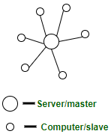
Centralized Systems
Client/server architecture
Components of Centralized System:
Node (Computer, Mobile, etc.).
Server.
Communication link (Cables, Wi-Fi, etc.).
Client sends a request to a company server and receives the response.
Server receives requests and respond
Example?
https://www.geeksforgeeks.org/comparison-centralized-decentralized-and-distributed-systems/

Slide 5
Centralized System contd…
Characteristics of Centralized System
Presence of a global clock
One single central unit
Dependent failure of components
Scaling
Only vertical scaling on central server is possible

Slide 6
Centralized System contd…
Advantages
Easy to physically secure
Smooth and elegant personal experience
Dedicated resources
More cost efficient for small systems upto a certain limit
Limitations
Can’t scale up vertically after a certain limit
Highly dependent on the network connectivity
Bottlenecks can appear when the traffic spikes

Slide 7
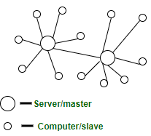
Decentralized Systems
Every node makes its own decision.
The final behavior of the system is the aggregate of the decisions of the individual nodes.
There is no single entity that receives and responds to the request.
Components of Decentralized System are,
Node (Computer, Mobile, etc.)
Communication link (Cables, Wi-Fi, etc.)

Slide 8
Characteristics of Decentralized System
Lack of a global clock
Multiple central units (Computers/Nodes/Servers)
Dependent failure of components

Slide 9
Decentralized System contd…
Advantages
High availability
More autonomy and control over resources
Limitations
Coordination issues
No way to regulate a node on the system

Slide 10
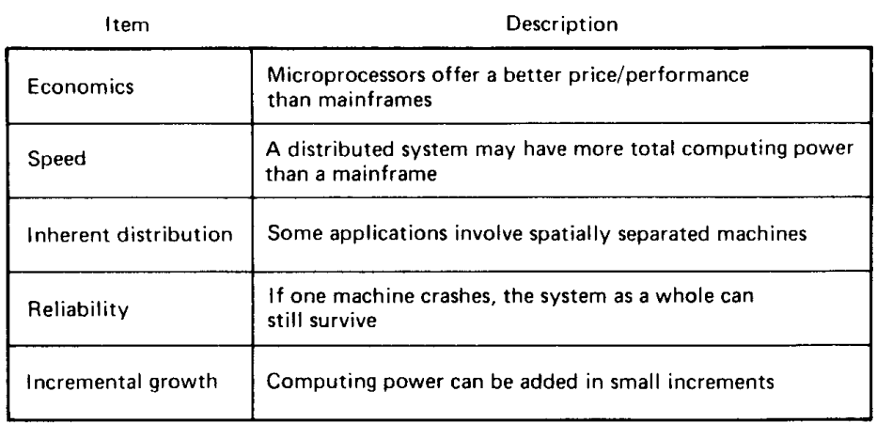
Advantages over Centralized OS

Slide 11
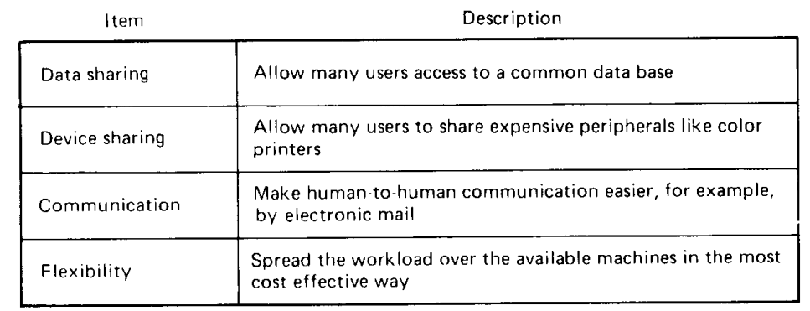
Advantages over PCs

Slide 12
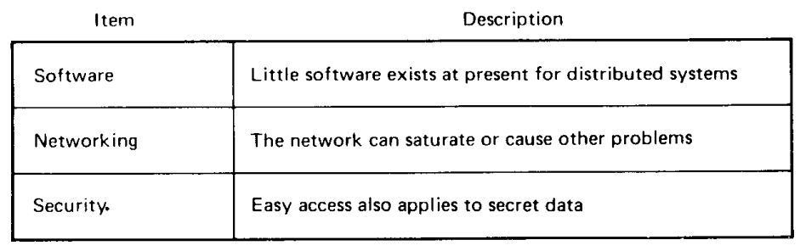
Disadvantages

Slide 13
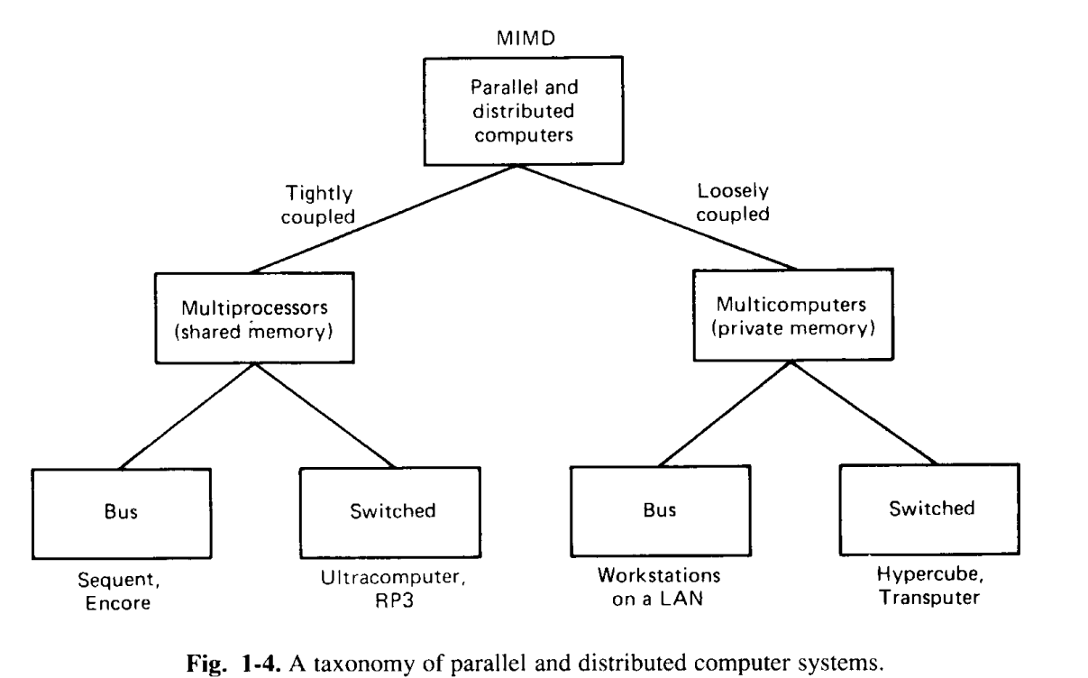
Hardware concepts

Slide 14
Loosely vs tightly coupled systems
 | Loosely Coupled | Tightly Coupled
Memory | Distributed memory in loosely coupled multiprocessor system | Shared memory, in tightly coupled multiprocessor system
Data rate | Low data rate | high data rate
Cost | Less costly | More costly
Memory conflicts | Memory conflicts don’t take place. | While tightly coupled multiprocessor system have memory conflicts.
 | Low degree of interaction between tasks. | High degree of interaction between tasks.
 | Direct connection between processor and I/O devices. | IOPIN helps connection between processor and I/O devices.
Application | Applications of loosely coupled multiprocessor are in distributed computing systems. | Applications of tightly coupled multiprocessor are in parallel processing systems.

Slide 15
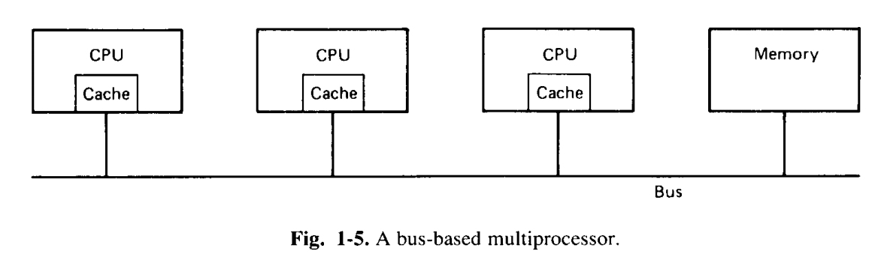
Bus-based multiprocessor
Problem: Overburden on Bus
Solution?
Issue with Cache
write-through cache
Snoopy Cache

Slide 16
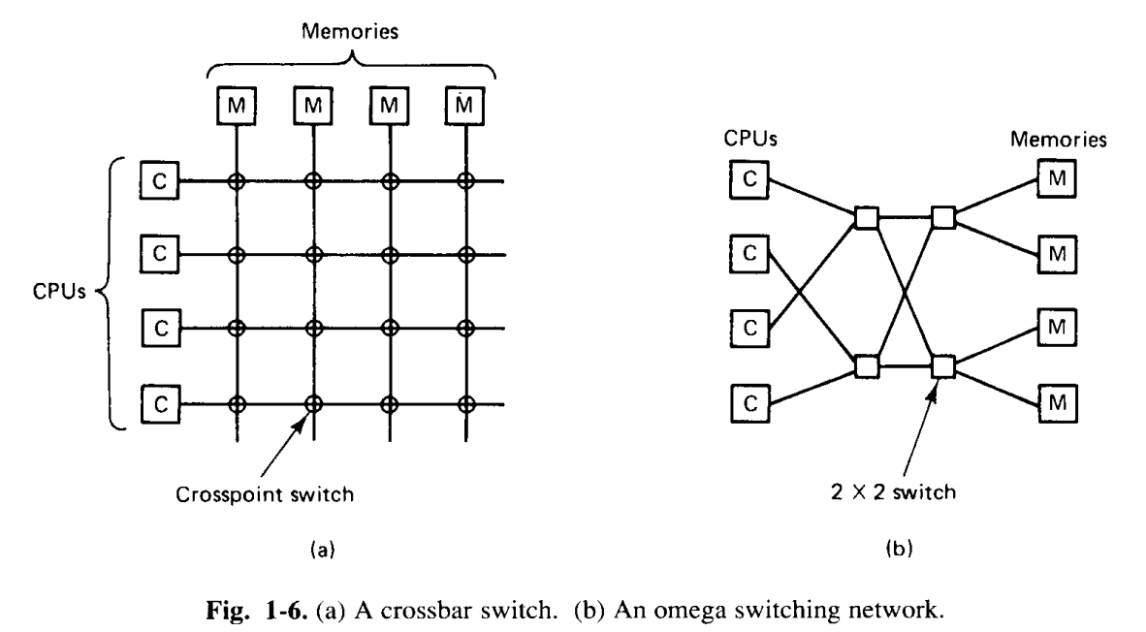
Switched multiprocessor
Hierarchical systems,
NUMA (NonUniform Memory Access)
if n increases?

Slide 17
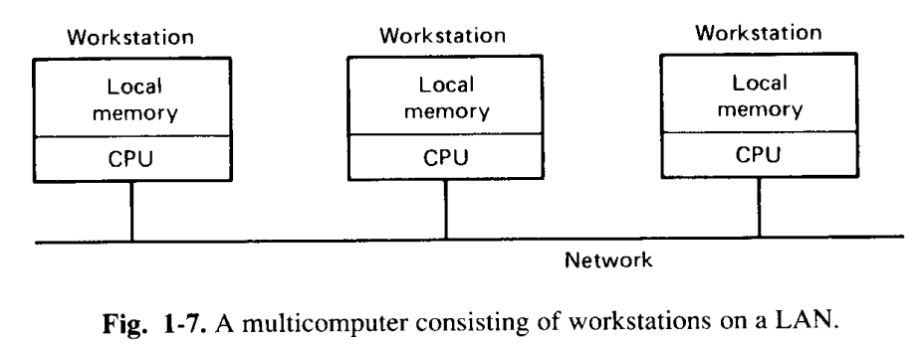
Bus-based Multicomputers

Slide 18
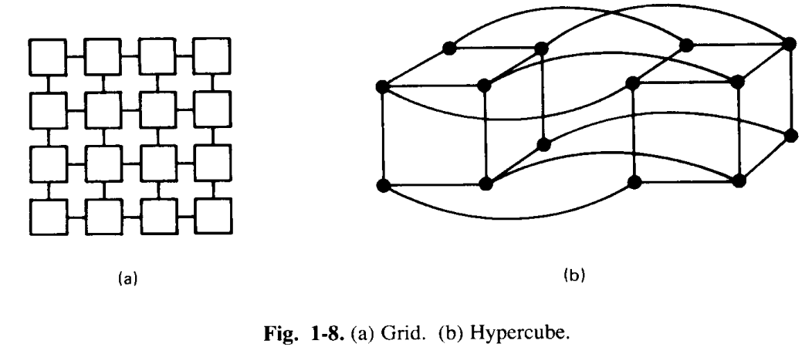
Switched Multicomputer

Slide 19
Software concepts
Sharing of a printer on networking
Loosely coupled
Running a chess programme in parallel
Tightly coupled
In total 8 combinations of hardware (4) and software (2)

Slide 20

Network Operating systems
Workstations connected with LAN
To copy data from one machine to another

Slide 21
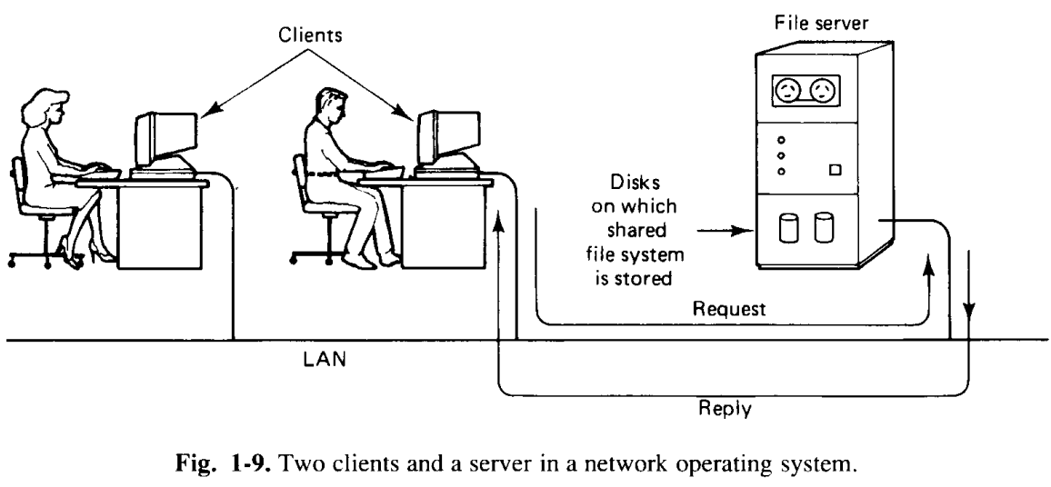
Network Operating System
shared, global file system accessibility

Slide 22
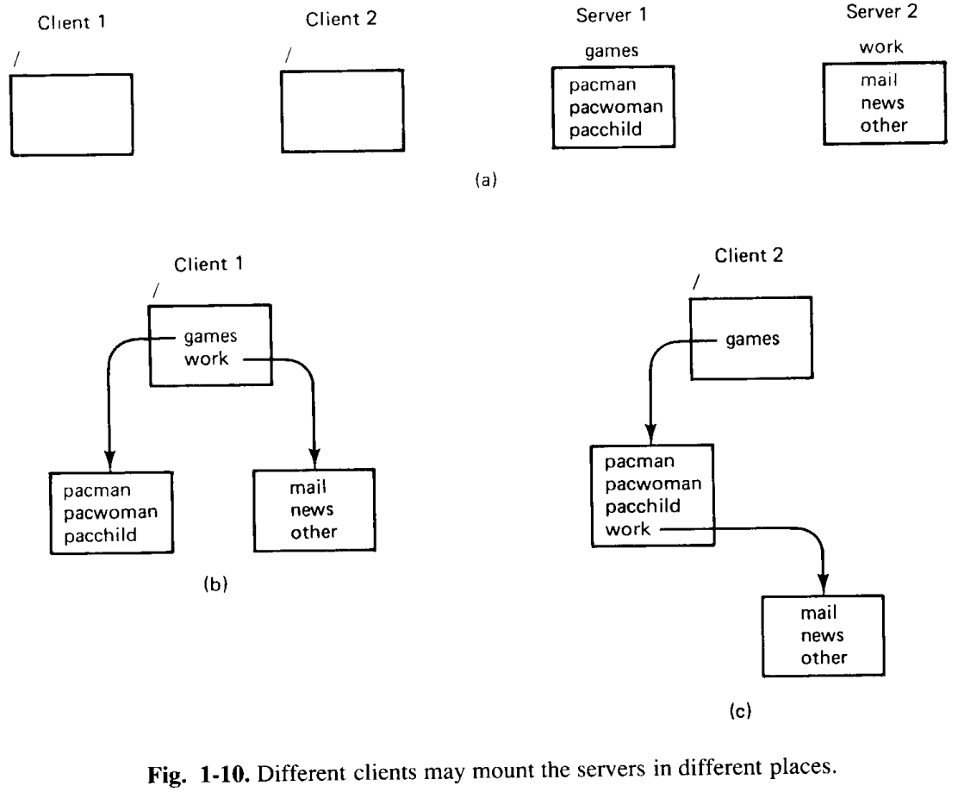
Network Operating System
Mounting of files

Slide 23
Network Operating System
Should all machines run the same OS?
Not required!
If running on different, they must agree on the format and meaning of all messages that they may potentially exchange.
High degree of autonomy and a few system-wide requirements

Slide 24
Distributed Operating Systems
Illusion: single-system image
Entire network of computer is a single timesharing system, rather than a collection of distinct machines.
Single, global inter-process communication mechanism
Don’t have different mechanisms on different machines or different mechanisms on local communication and remote communication.
Global protection scheme
Same process management
Same file system

Slide 25
Loosely coupled software
Loosely coupled Hardware
Network Operating Systems
??
Tightly coupled software
Loosely coupled Hardware
Distributed Operating Systems
??
Tightly coupled software
Tightly coupled Hardware
Multiprocessor Timesharing Operating Systems
??

Slide 26
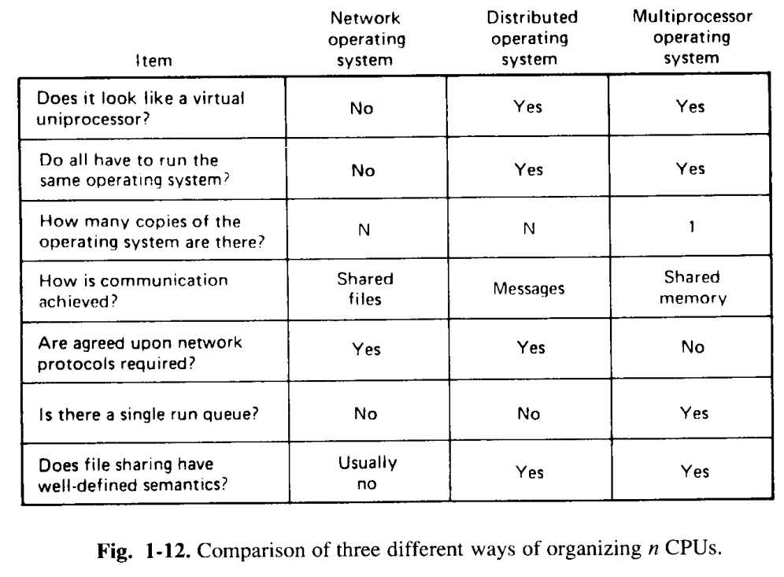
Differences

Slide 27
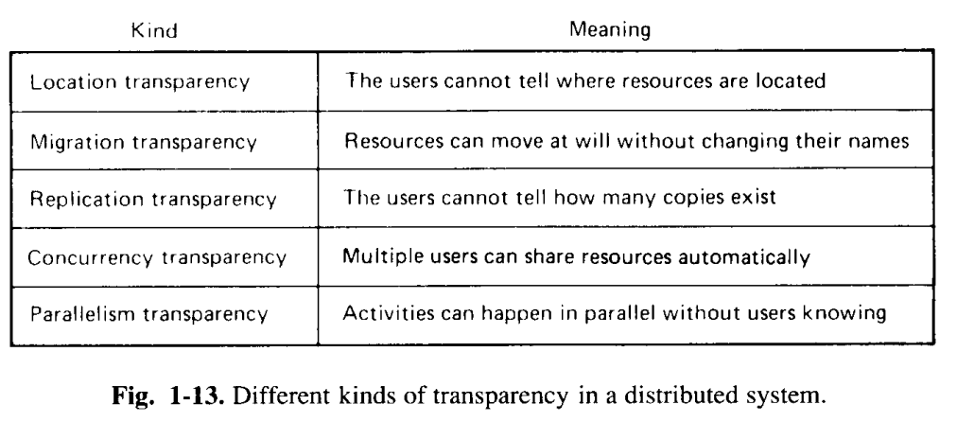
Design issues
Transparency
How to achieve a single-system image

Slide 28
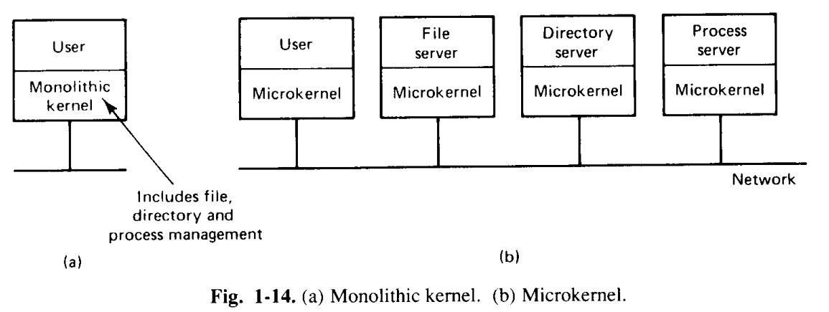
Design issues contd…
Flexibility

Slide 29
Design issues contd…
Reliability
With four file servers, each with a 0.95 chance of being up at any instant, the prob of all four being down simultaneously is ____
Availability
Security
Performance
Scalability

Slide 30
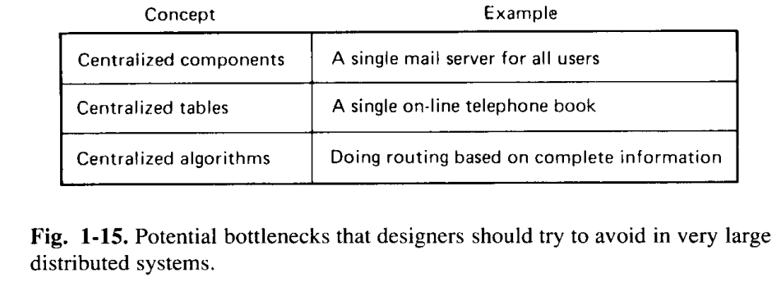
Potential bottlenecks

Slide 31
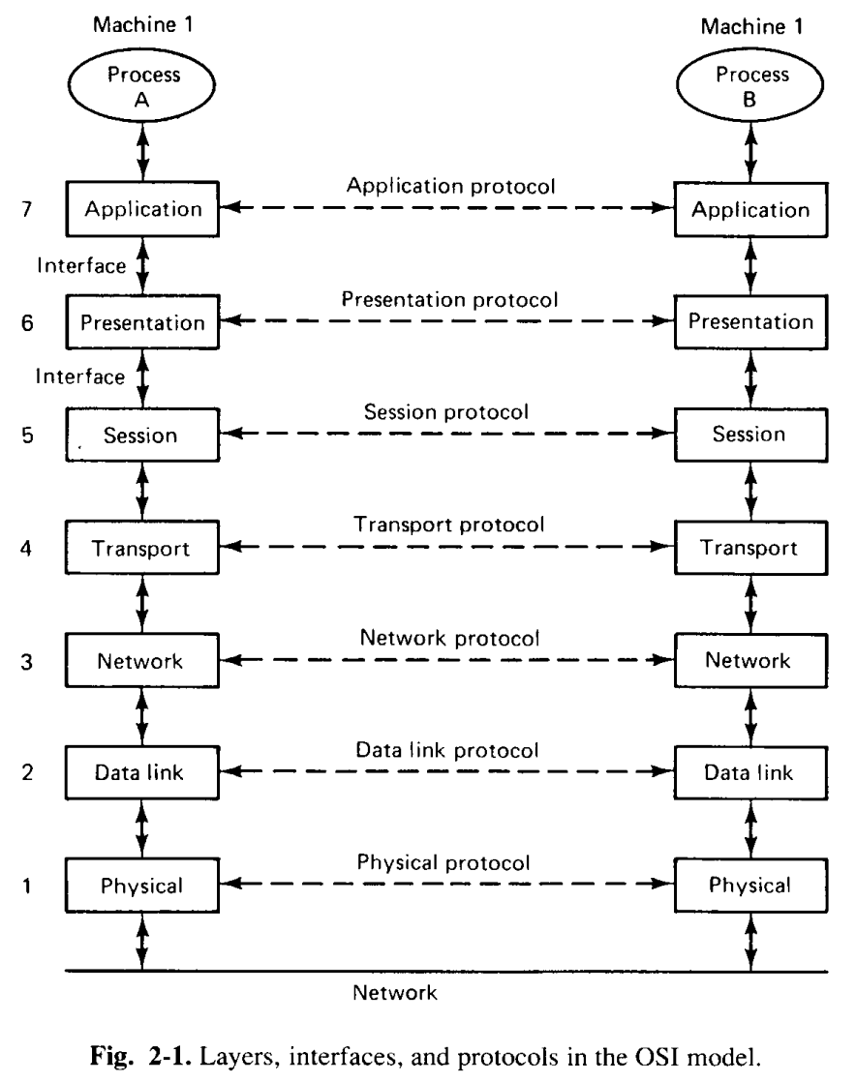
Communication in DS

Slide 32
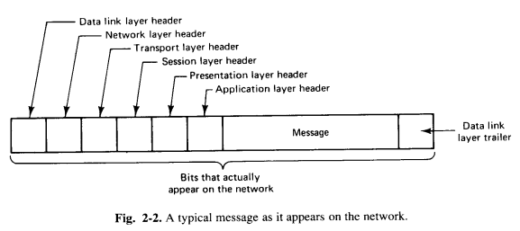
Typical message on network

Slide 33
Clients and Servers
The Client-server model is a distributed application structure that partitions task or workload between the providers of a resource or service, called servers, and service requesters called clients.
In the client-server architecture, when the client computer sends a request for data to the server through the internet, the server accepts the requested process and deliver the data packets requested back to the client.

Slide 34
Clients and Servers (contd…)
To avoid the considerable overhead of the connection-oriented protocols such as OSI or TCP/IP , the client server model is usually based on a simple connectionless request/reply protocol.
The client sends a request message to the server asking for some service.
The server does the work and returns the data requested or an error code indicating why the work could not be performed.
The primary advantage of the model is the simplicity because the client sends a request and gets an answer. No connection has to be established before use or torn down afterward. The reply message serves as the acknowledgement to the request.
From the simplicity comes another advantage : efficiency the protocol stack is shorter and thus more efficient.

Slide 35
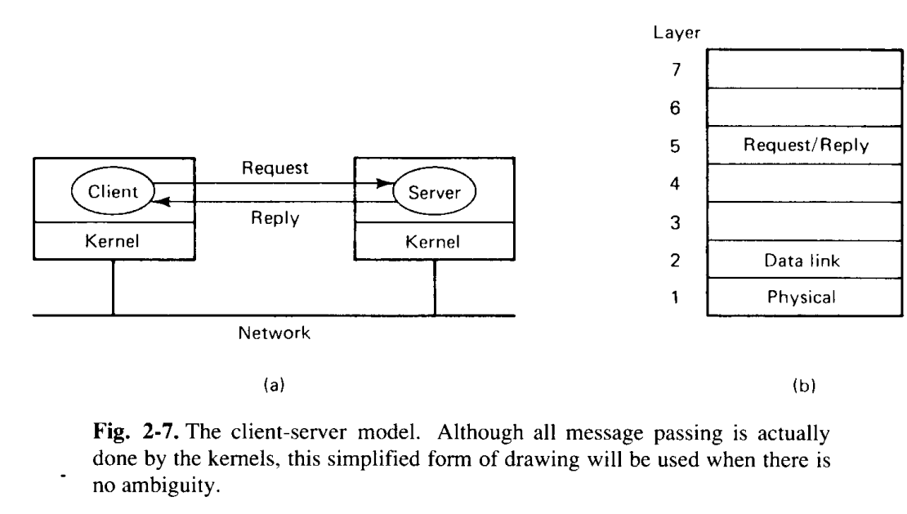
Clients and Servers
Use request/reply protocol

Slide 36
Clients and Servers (contd…)
Assuming that all the machines are identical , only three levels of protocols are needed as shown in fig 2.7(b).
The physical and data link protocols take care of getting the packets from client to server and back. These are handles by the hardware for example, an Ethernet
No routing is needed and no connections are established, so layer 3 and 4 are not required.
Layer 5 is the request/reply protocol. It defines the set of legal requests and the set of legal replies to these requests.
There is no session management because there are no sessions.
The upper layer are not needed either.

Slide 37
Clients and Servers (contd…)
Due to this simple structure, the communication services provided by the (micro)kernel can be reduced to two system calls , one for sending messages and one for receiving them.
Theses system calls can be invoked through library procedures, say
send(dest, &mptr) and receive(addr, &mptr).
The former sends the message pointed to by mptr to a process identified by dest and causes the caller to be blocked until the message has been sent.
The latter causes the caller to be blocked until a message arrives.
When one does, the message is copied to the buffer pointed to by mptr and the caller is unblocked.
The addr parameter specifies the address to which the receiver is listening.

Slide 38
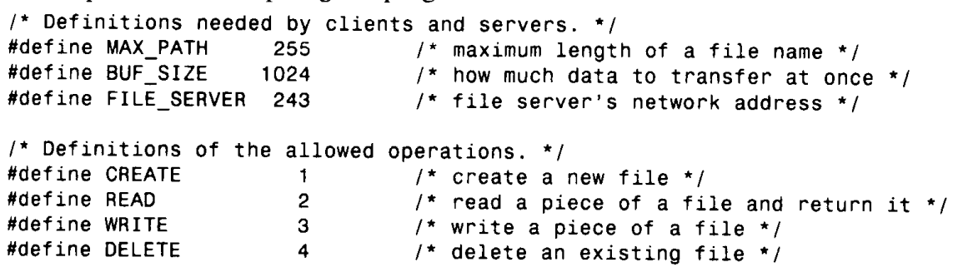
Clients and Servers (contd…)

Slide 39
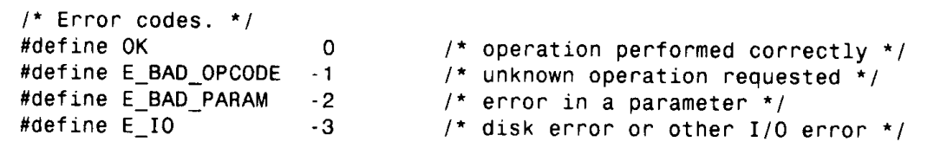
Clients and Servers (contd…)

Slide 40
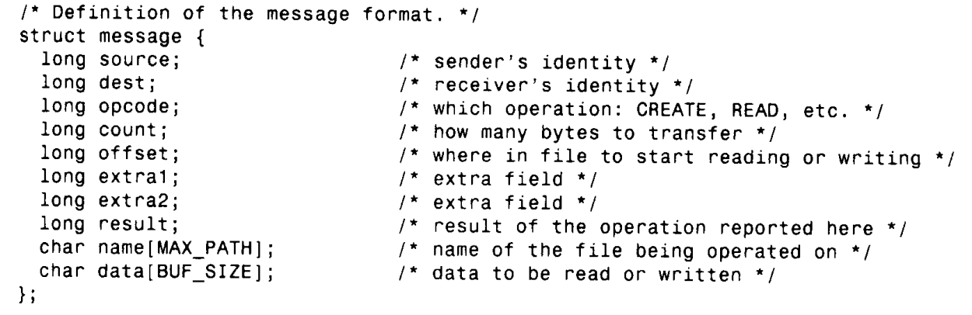
Clients and Servers (contd…)

Slide 41
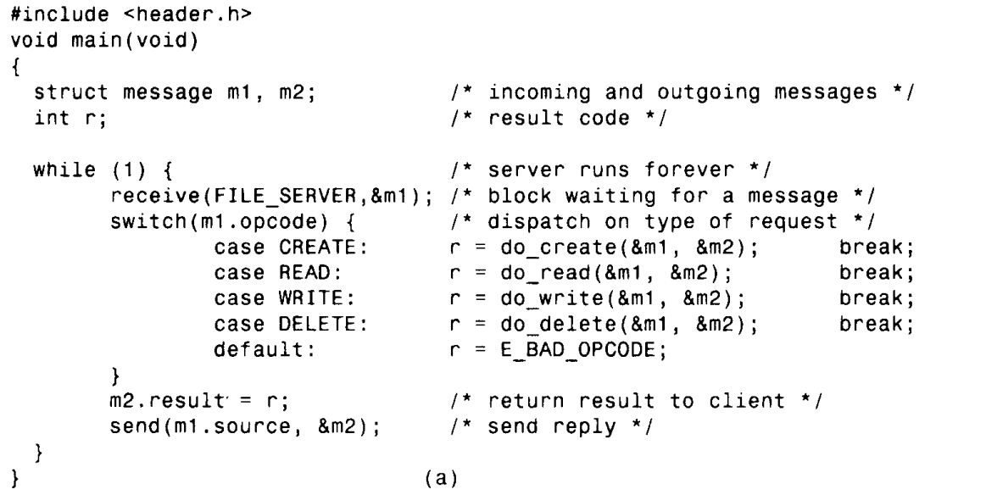
Clients and Servers (contd…)

Slide 42
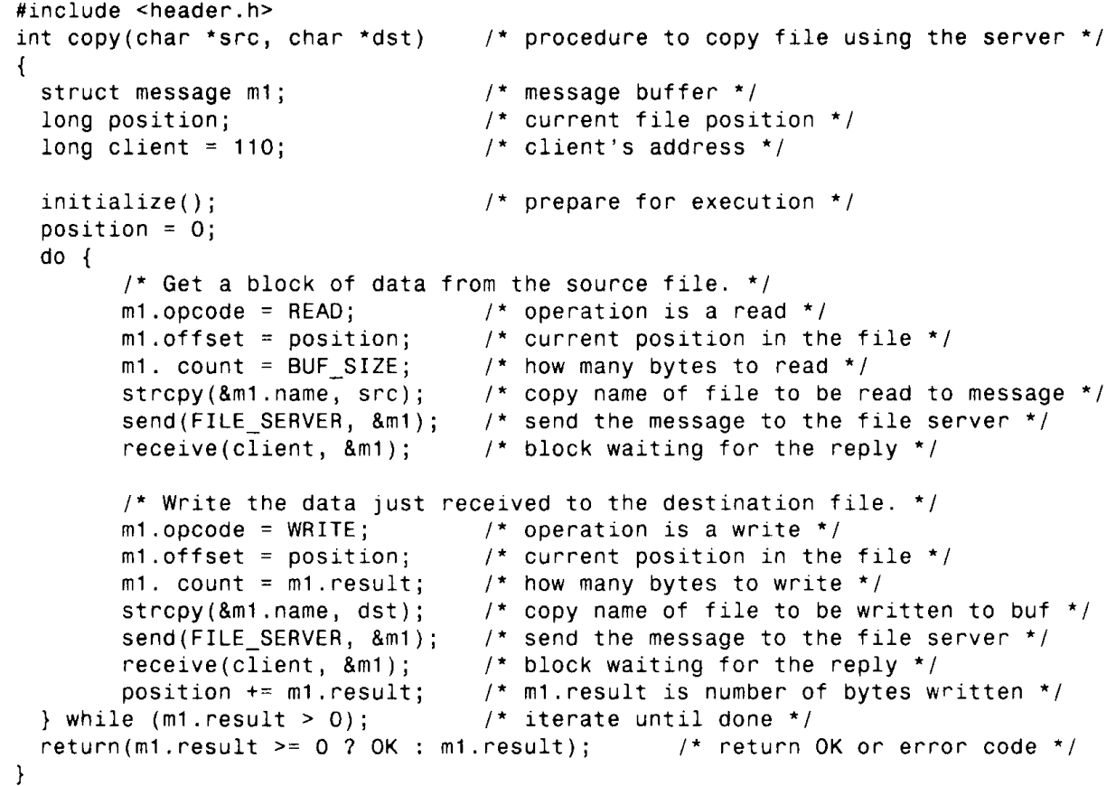
Clients and Servers (contd…)

Slide 43
Issues related to Client-Server Model
Addressing
Blocking and non-blocking
Buffering
Reliability

Slide 44
Issues related to Client-Server Model-(contd…)
Addressing
If there is only one process running on the destination machine, the kernel will know what to do with the incoming message — give it to the one and only process running there. However, what happens if there are several processes running on the destination machine? Which one gets the message? The kernel has no way of knowing.
So, for that purpose an addressing system sends messages to processes rather than to machines.
How to identified the processes ?

Slide 45
Issues related to Client-Server Model-(contd…)
Case 1:
One common scheme is to use two part names, specifying both a machine and a process number.
For example, 243.4 or 4@243 designates process 4 on machine 243. The machine number is used by the kernel to get the message correctly delivered to the proper machine, and the process number is used by the kernel on that machine to determine which process the message is intended for.

Slide 46
Issues related to Client-Server Model-(contd…)
Case 2:
Another approach is that on a LAN that supports broadcasting
The sender can broadcast a special locate packet containing the address of the destination process. Because it is a broadcast packet, it will be received by all machines on the network.
All the kernels check to see if the address is theirs, and if so, send back a here I am message giving their network address (machine number).
The sending kernel then uses this address, and furthermore, caches it, to avoid broadcasting the next time the server is needed.

Slide 47
Issues related to Client-Server Model-(contd…)
Case 3:
The broadcasting puts extra load on the system. This extra load can be avoided by providing an extra machine to map high-level (i.e., ASCII) service names to machine addresses, as shown in Fig. 2-10(c).
When this system is employed, processes such as servers are referred to by ASCII strings, and it is these strings that are embedded in programs, not binary machine or process numbers.
Every time a client runs, on the first attempt to use a server, the client sends a query message to a special mapping server, often called a name server, asking it for the machine number where the server is currently located. Once this address has been obtained, the request can be sent directly.

Slide 48
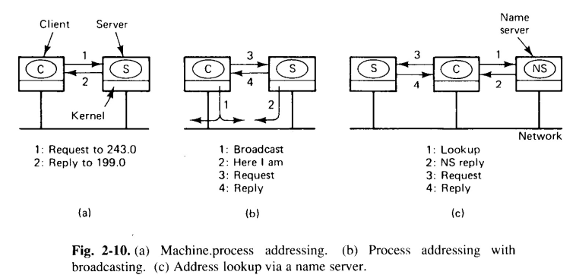
Issues related to Client-Server Model-(contd…)

Slide 49
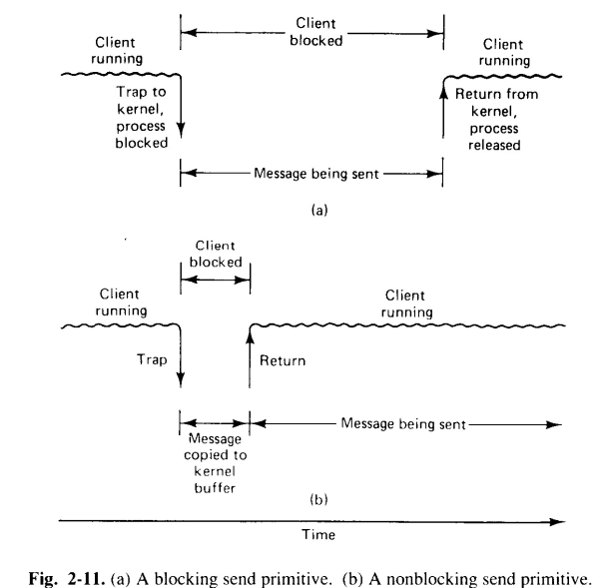
Issues related to Client-Server Model-(contd…)
Blocking
While the message is being sent, the sending process is blocked (i.e., suspended). The instruction following the call to send is not executed until the message has been completely sent, as shown in Fig. 2-1l(a) Similarly, the process remains suspended in receive until a message arrives

Slide 50
Issues related to Client-Server Model-(contd…)
Nonblocking
If send is nonblocking, it returns control to the caller immediately, before the message is sent. The advantage of this scheme is that the sending process can continue computing in parallel with the message transmission, instead of (b) A non blocking send having the CPU go idle primitive.
Challenges?

Slide 51
Issues related to Client-Server Model-(contd…)
Solutions:
Blocking send (CPU idle during message transmission)
Nonblocking send with copy (CPU time wasted for extra copy)
Nonblocking send with interrupt (prog difficult)

Slide 52
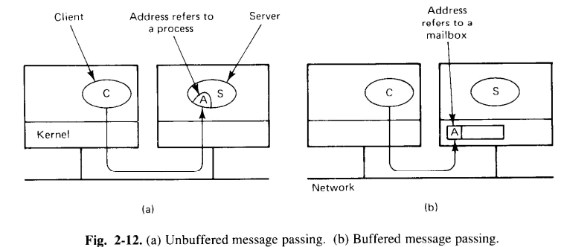
Issues related to Client-Server Model-(contd…)
Buffered vs unbuffered primitives
Challenges?
Client sends before server initiate receive
Server not aware about the process and where to save incoming message
Solutions:
Time-out
Client may have to attempt several times
Server may keep incoming messages for a little while
Problem of storing incoming messages

Slide 53
Issues related to Client-Server Model-(contd…)
Buffered vs unbuffered
Mail box
Problem:
Mailbox is full

Slide 54
Issues related to Client-Server Model-(contd…)
Reliable versus Unreliable primitives
Problem:
In case of blocking primitive, when a system resumes/restarted, there is no guarantee that the message has been delivered
Solutions
Redefine the semantics of send to be unreliable
E.g. post office
Receiving kernel sends an acknowledgement back to the kernel of sending machine
Advantage of request and response model
No ACK is sent, Kernel sends response and that itself is an ACK
But no ACK for reply

Slide 55
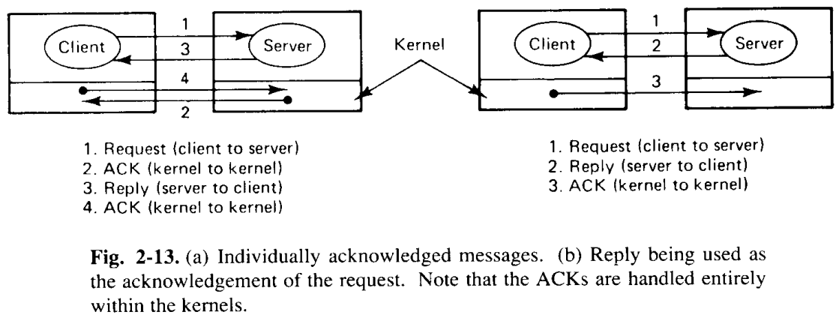
Issues related to Client-Server Model-(contd…)
Reliable versus Unreliable

Slide 56
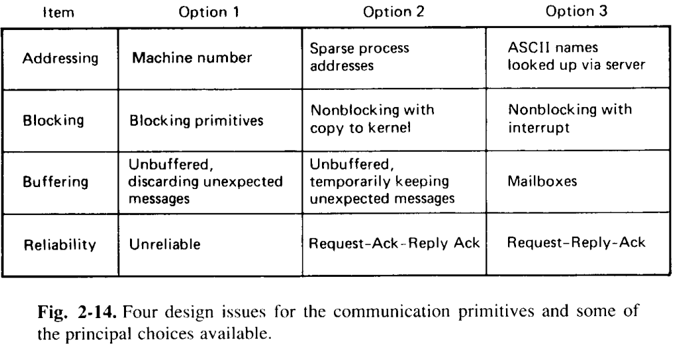
Issues related to Client-Server Model-(contd…)

Slide 57
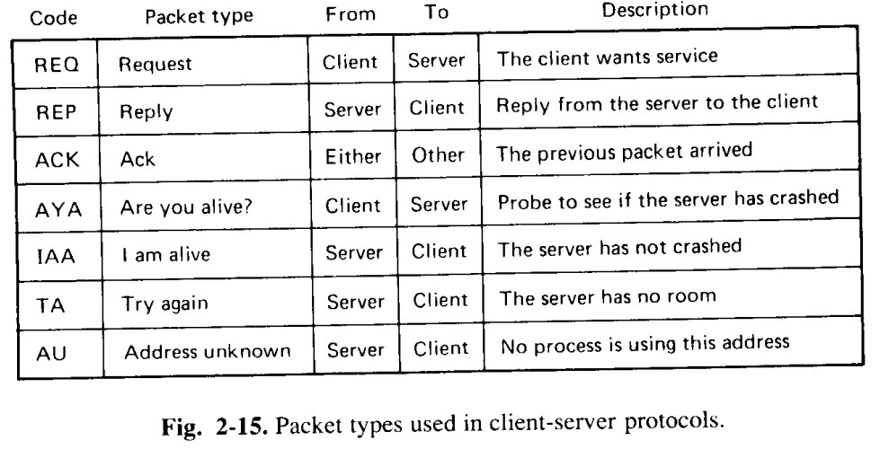
Client-Server Model-(contd…)

Slide 58
References
A S Tanenbaum, Maarten Van Steen, Distributed Operating systems, Pearson, 2014

